Slide 1
Crime Rate in D.C.
Team - Crime hunters
Wonjune Lee (G01403890), Jinuk Seo (G01464199)
https://rpubs.com/Manta/1317028

Slide 2
Data sources
01
02
03
04
Metropolitan Police Department
Open Data DC
All property crimes over past 5 years
(type, place, time, …)
Alcohol License
Business Locations
Open Data DC
Visualcrossing
Homeless Service Facilities
Temperature in D.C.

Slide 3
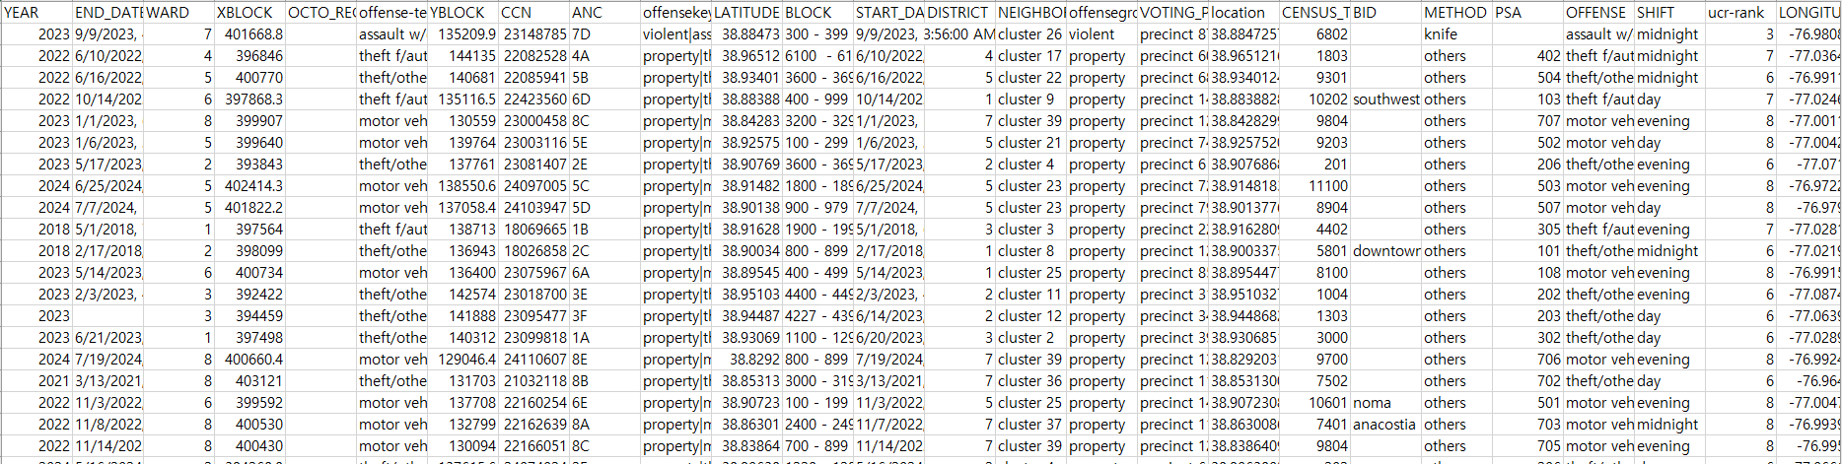
1. Metropolitan Police Department

Slide 4
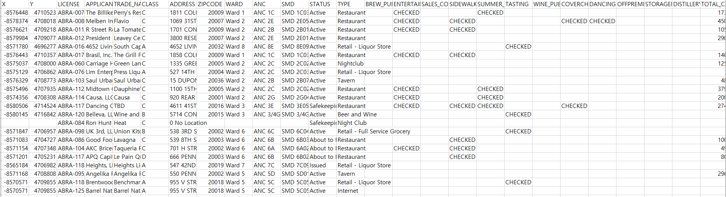
2. Alcohol License Business Locations

Slide 5
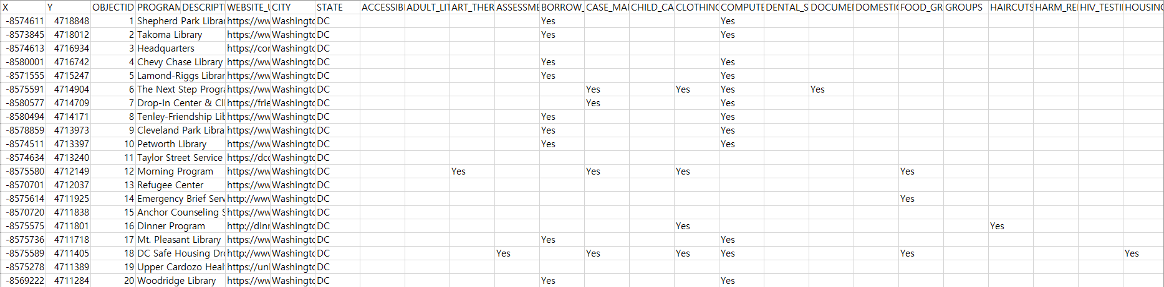
3. Homeless Service Facilities

Slide 6
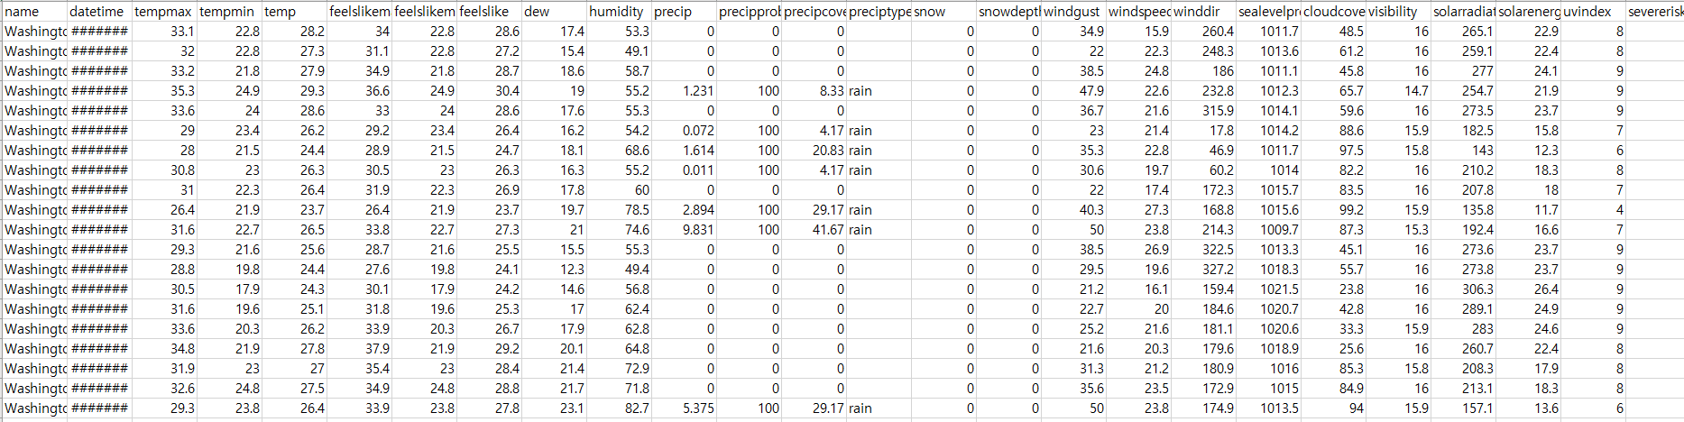
4. Temperature in D.C.

Slide 7
Why D.C. ?
01
Focusing on D.C. area

Slide 8
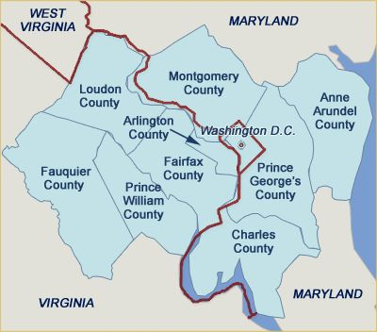
DC is near Fairfax county
househunt.com (n.d.)

Slide 9
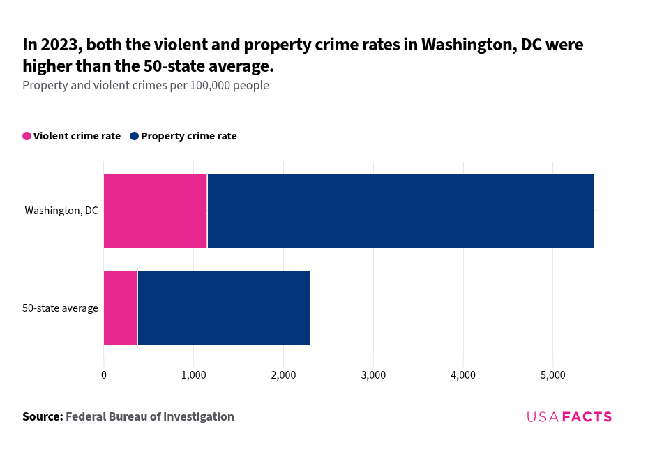
Is DC dangerous ?
USAFACTS (2023)

Slide 10
D.C. crime rate
02

Slide 11
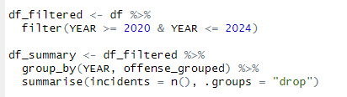
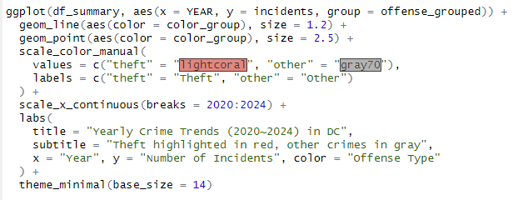
Change over Time
Filtering for years 2020 to 2024 and
summarizing the data by year and offense type
Creating the line plot

Slide 12
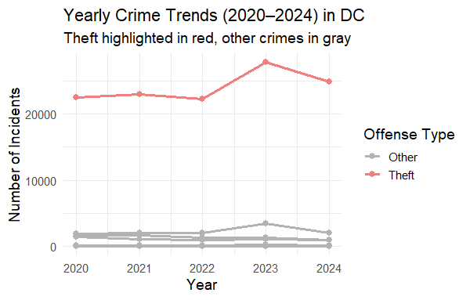
Change over Time

Slide 13
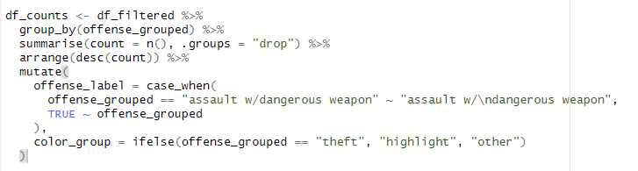
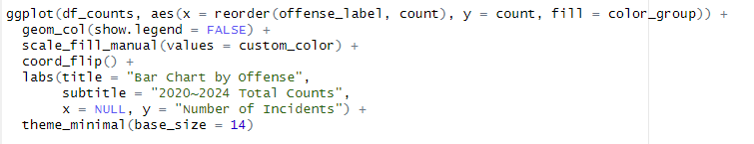
Crime rate by type
Summarize incident counts
by offense type
Creating the
horizontal bar chart

Slide 14
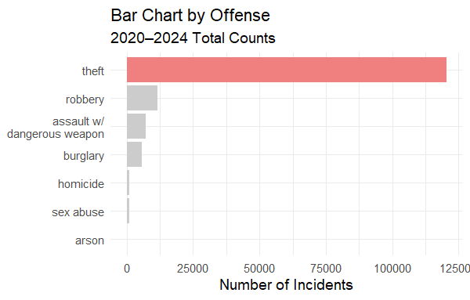
Crime rate by type

Slide 15
02
When?

Slide 16
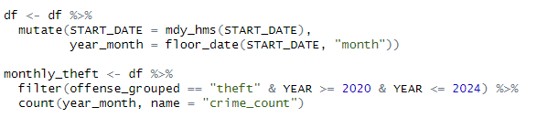
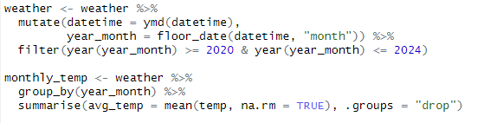
Monthly Theft count and Temperature
Convert dates and extract month and
aggregate monthly theft crime counts
Load and process weather data and
calculate monthly average temperature

Slide 17
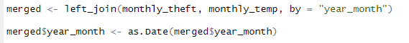
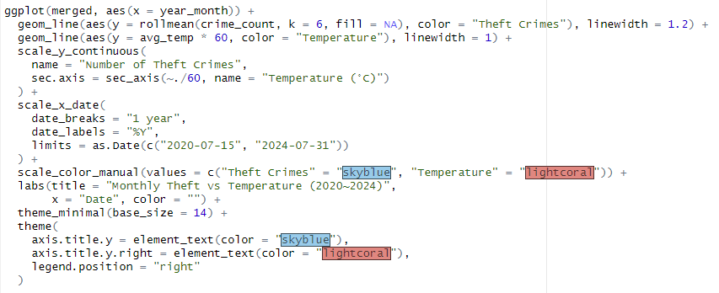
Monthly Theft count and Temperature
Merge crime and weather data
Create Dual-Axis Time Series Plot

Slide 18
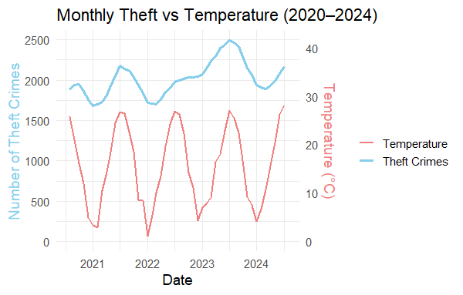
Monthly Theft count and Temperature

Slide 19
Monthly Theft count and Temperature

Slide 20
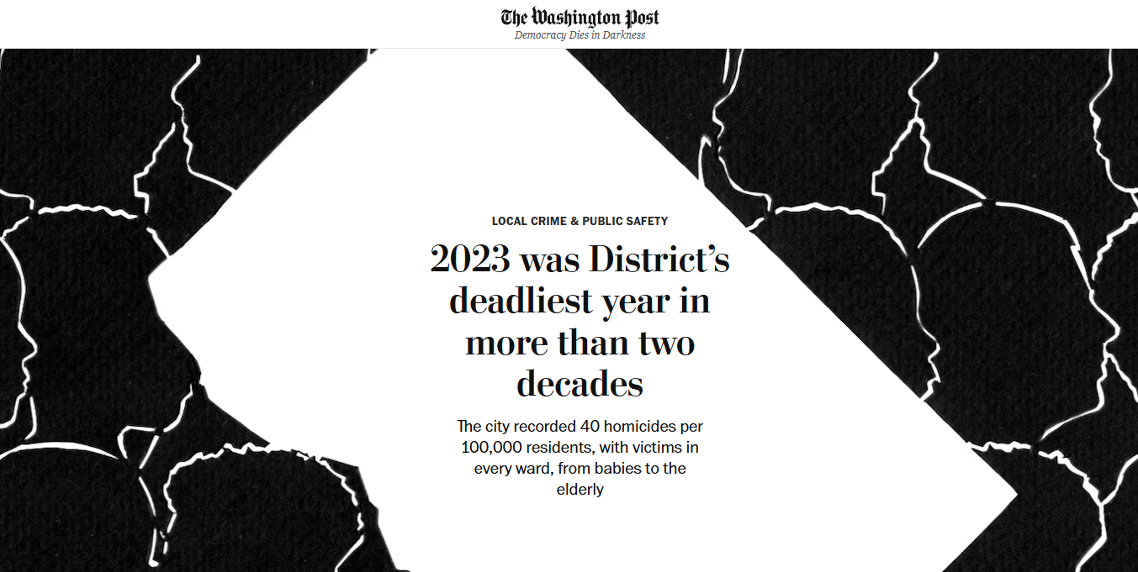
Monthly Theft count and Temperature
thewashingtonpost (2023)

Slide 21
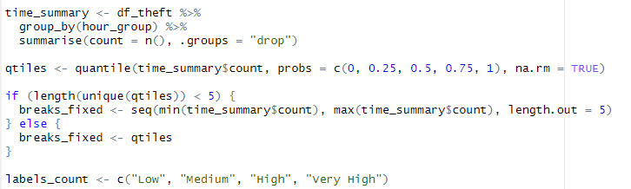
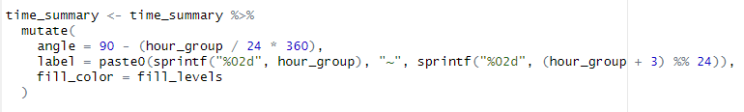
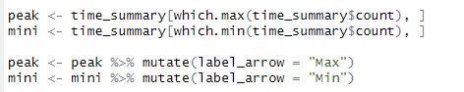
Theft count by Time
Count thefts per 3-hour interval and
classify frequency levels using quantiles
customize labels and
polar coordinates
Identify peak and minimum theft hours

Slide 22
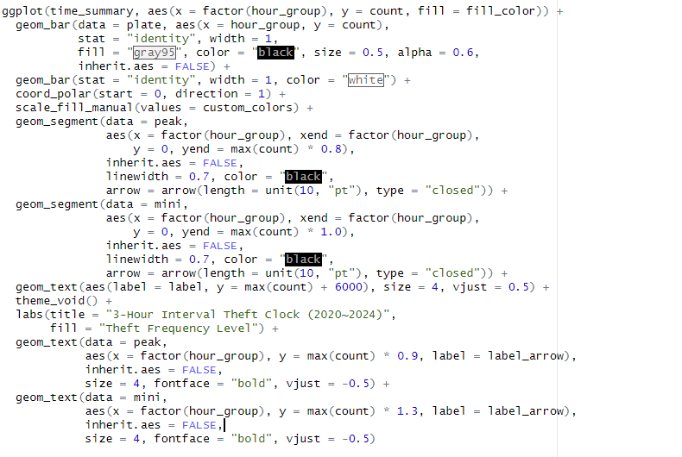
Theft count by Time
Plot the Polar Bar Chart
Base structure and background plate
Convert to clock shape
and apply colors
Arrows pointing to
peak and low times
Annotate
max and min

Slide 23
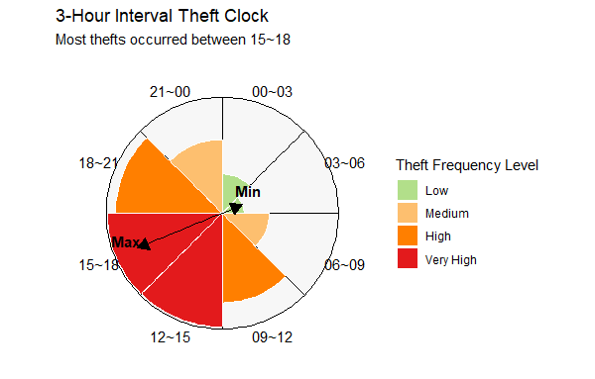
Theft count by Time

Slide 24
03
Where?

Slide 25
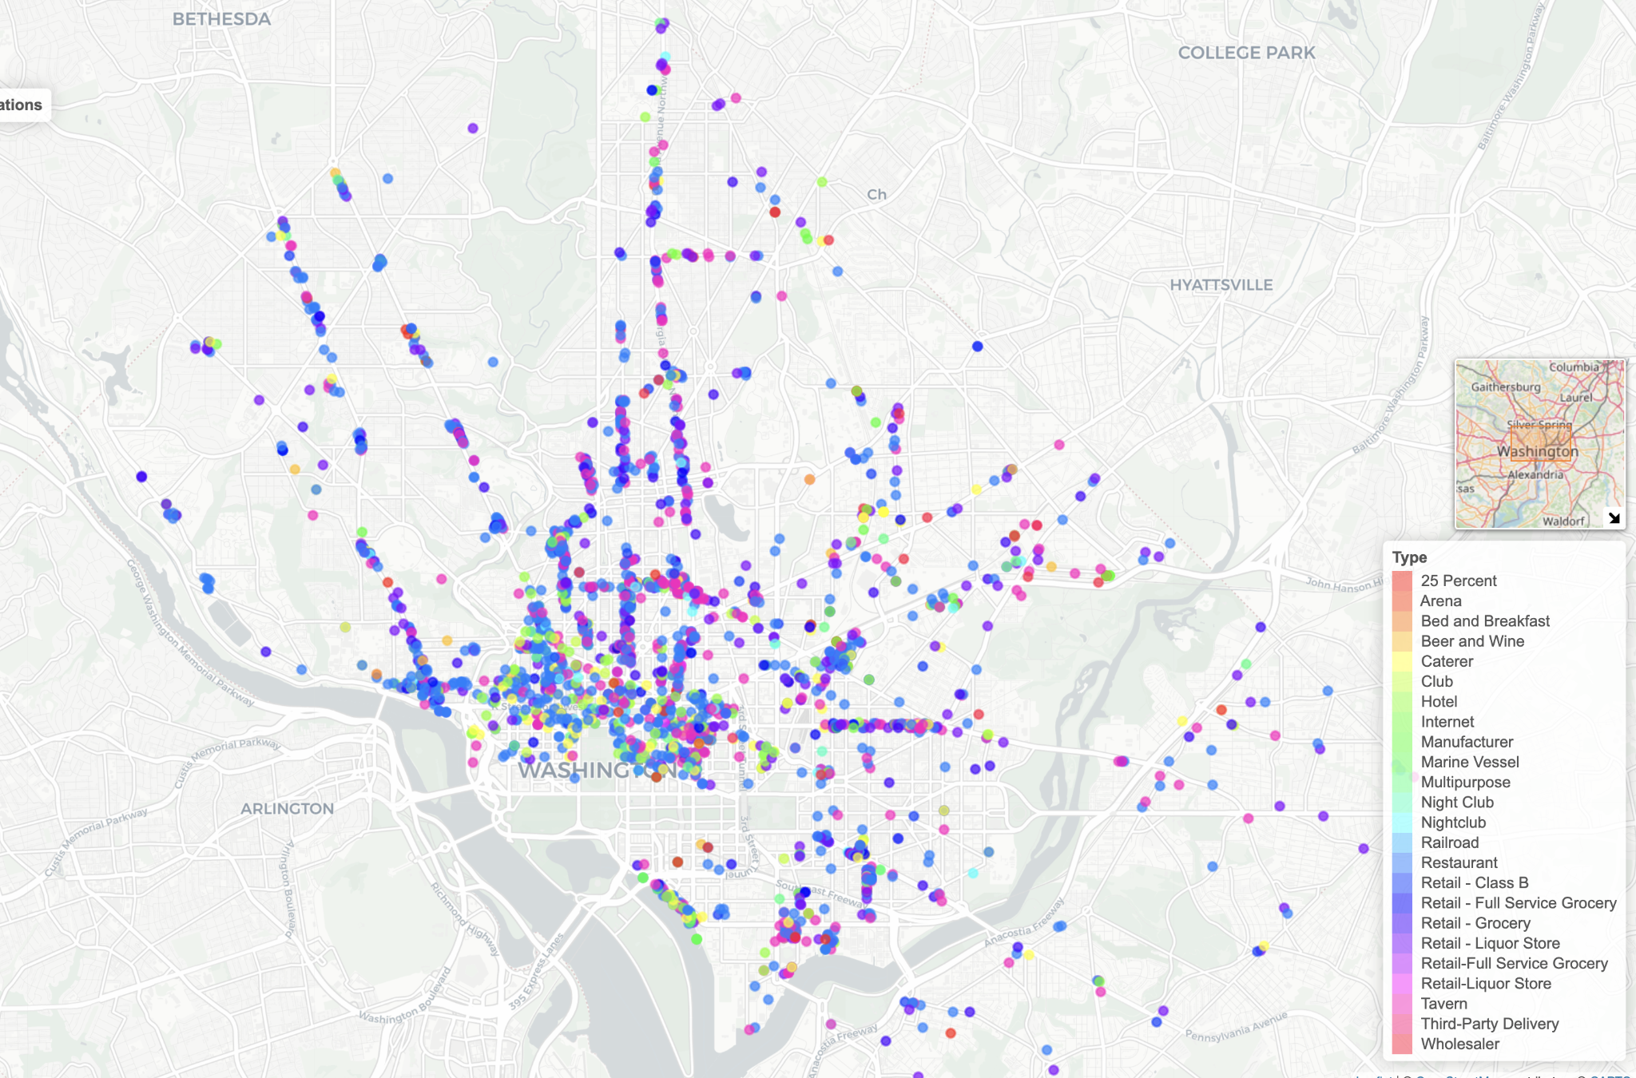
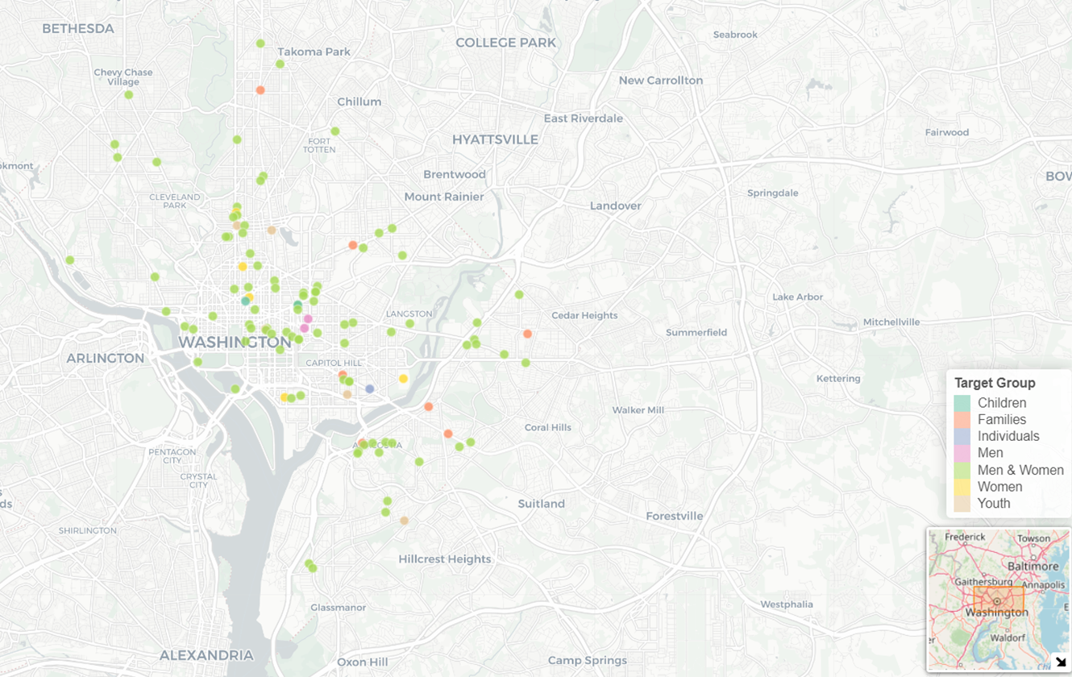
Alcohol Business & Homeless facilities

Slide 26
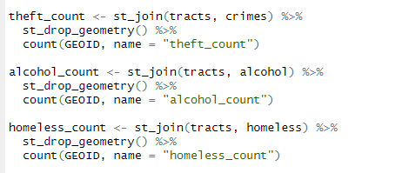
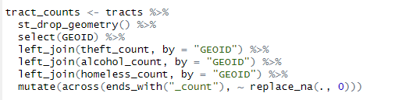
Correlation
Count points within each tract
(theft, alcohol business, homeless center)
Join all counts into one data frame

Slide 27
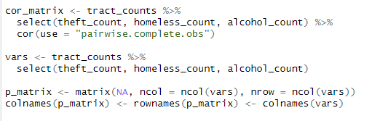
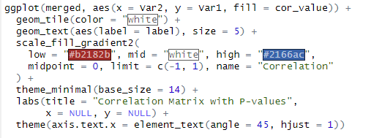
Correlation
Calculate correlation matrix
and p-values
~ Reshape for heatmap process ~
Visualize as
correlation heatmap with p-value

Slide 28
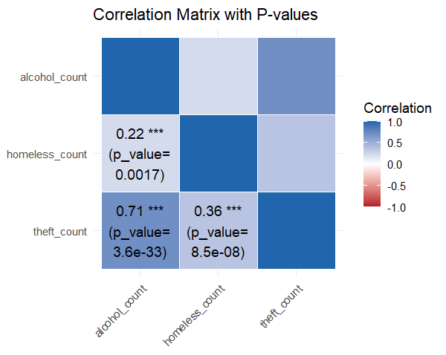
Correlation

Slide 29
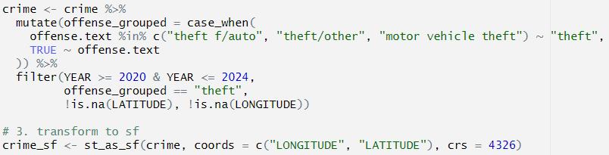
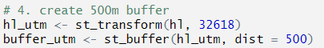
Buffer visualization
Filter and convert
crime data to sf object
Create 500m buffers
around homeless facilities

Slide 30
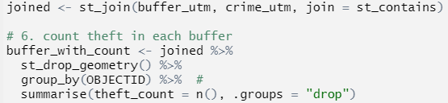
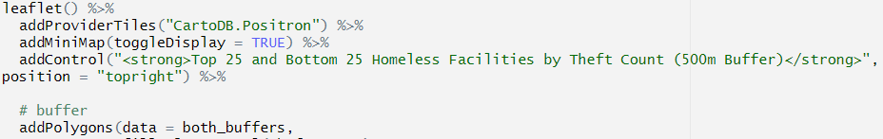
Buffer visualization
Join crime with
buffers and count theft
per buffer
Visualize
top and bottom
25 buffers in Leaflet

Slide 31
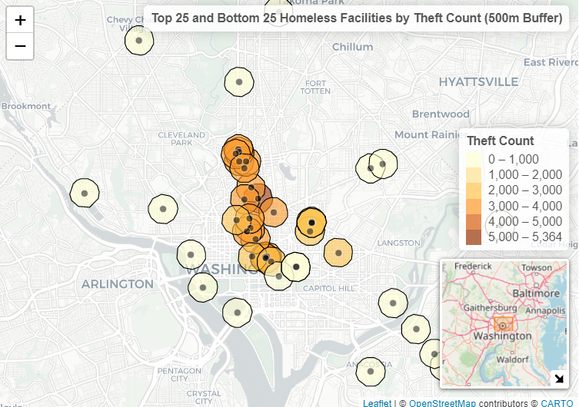
Buffer Map - Homeless Facility vs theft
The central downtown D.C. area shows the highest theft activity near homeless facilities
(Stackoverflow, 2016)
(Din, 2020)

Slide 32
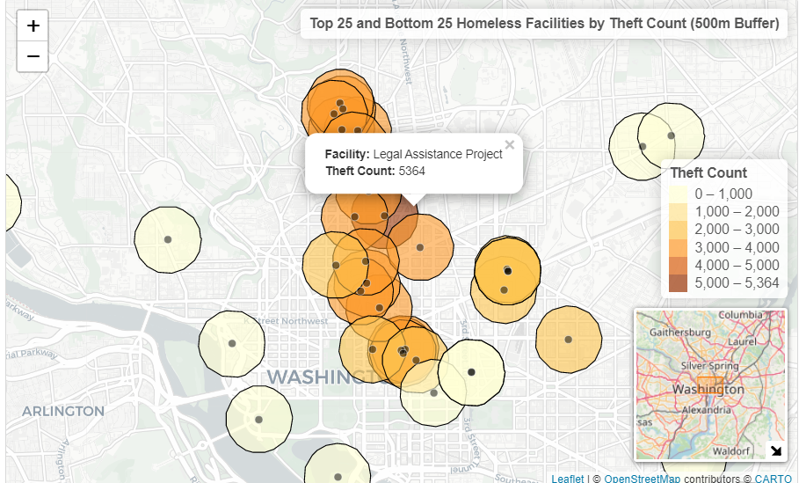
Buffer Map - Homeless Facility vs theft
The facility with the highest theft count is Legal Assistance Project, with 5,364 incidents

Slide 33
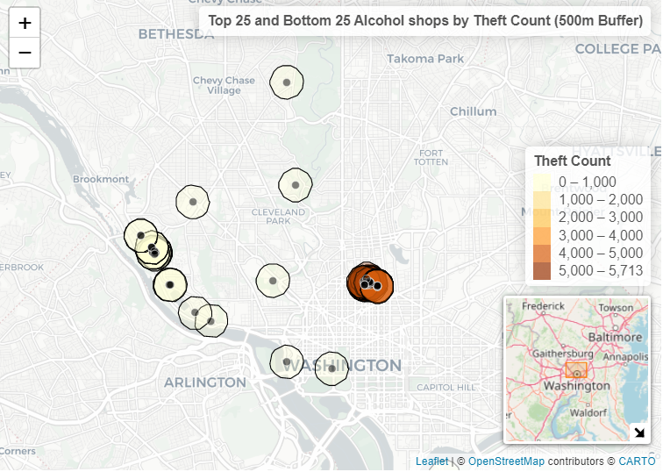
Buffer Map - Alcohol business vs theft
The highest theft counts are concentrated in the
U Street NW area.
This street is known as “Black Broadway” for nightlife, contributing to increased theft incidents
in the area.

Slide 34
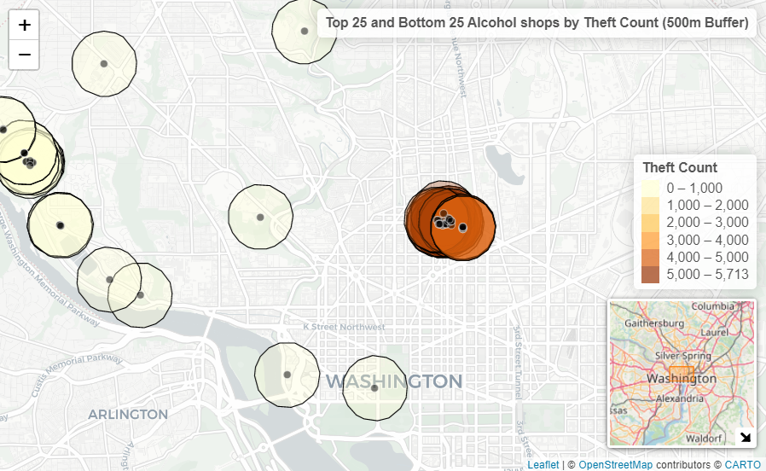
Buffer Map - Alcohol business vs theft
Mama nightclub area has the highest
count of 5,713 thefts.

Slide 35
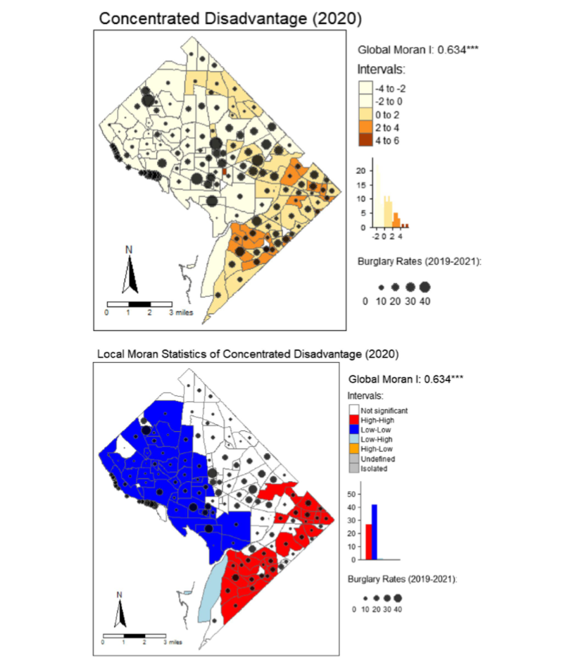
Homeless facilities and alcohol businesses in our mapps correlates with areas of higher burglary or disadvantage in the Carlos's map.
Both show spatial clustering of crime, especially in the central and southeastern parts of DC.
Vilalta, C., Lopez-Ramirez, P., Sanchez, T., & Fondevila, G. (2024)

Slide 36
Pros and Cons of buffer
✅
❌
Clearly shows high-risk zones near specific locations
Buffers can overlap, making it hard to tell which facility is responsible
Enables micro-scale analysis (within 500m) instead of whole neighborhoods
Risk of over-simplifying complex social factors
Easy to interpret with color-coded intensity
Combination of Quantitative and Spatial Analysis

Slide 37
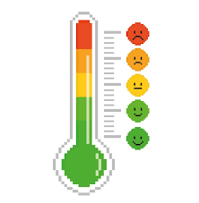

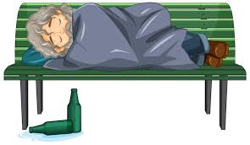

Prediction & Conclusion
There is a significant correlation between theft and environmental or social factors or time, such as:
Temperature (seasonality)
Alcohol businesses (nightlife clusters),
Homeless facilities (urban inequality).
Time ( 3 pm ~ 6 pm)

Slide 38
Prediction & Conclusion
So, if you're planning to visit D.C., especially around Black Broadway,
watch your pocket
in the afternoon (3pm to 6pm) !!!!!!!!!!!!!!!!

Slide 39
Thank you !

